Slide 2
Hemodynamic disorder s
Edema

Slide 4
Edema
excess fluid trapped in your body's tissues(extravasculary).
Interstitial
tissue
capillaries leak fluid
Serous cavity
Medication, pregnancy congestive heart failure, kidney disease or cirrhosis of the liver.

Slide 5
Mild Causes
Sitting or staying in one position for too long
Eating too much salty food
High blood pressure medications
No steroidal anti-inflammatory drugs
Steroid drugs
diabetes medications called thiazolidinediones
pregnant

Slide 6
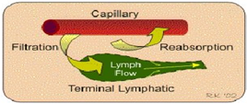
Mechanism of edema formation
Capillary hydrostatic pressure
Lymphatic obstruction
Hypoproteniemia
Capillary permeability

Slide 7
Types of edema
Peripheral edema: This affects the feet ankles, legs, hands, and arms. ...
Pulmonary edema: Excess fluid collects in the lungs, making breathing difficult. ...
Cerebral edema: This occurs in the brain. .
Macular edema: This is a serious complication of diabetic retinopathy
Hydropercardial edema : in pericardial sac

Slide 8
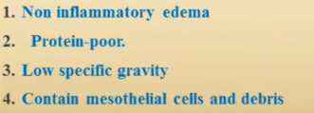
systemic conditions that alter the pressure in blood vessels, causing fluid to leave the vascular system
is fluid buildup caused by tissue leakage due to inflammation or local cellular damage
4- contain .high specific gravity ,inflammatory cells, paranchymal cell

Slide 9
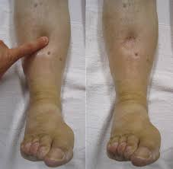
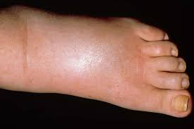
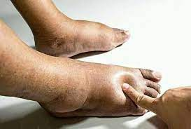

Slide 10
